Slide 1
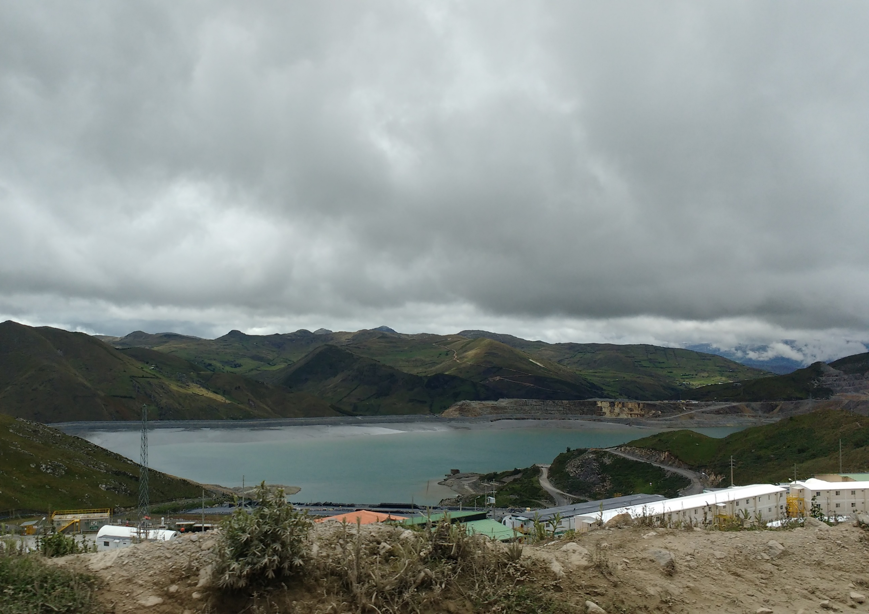


An operational system for tailings dam monitoring by bringing together remote sensing, meteorological and on-site observations
Marta Roca, Eleanor Ainscoe, Gregor Petkovsek,
Mark Wetton, Ye Liu, Mark Davison, Alberto Riera
HR Wallingford, Wallingford UK

Slide 2
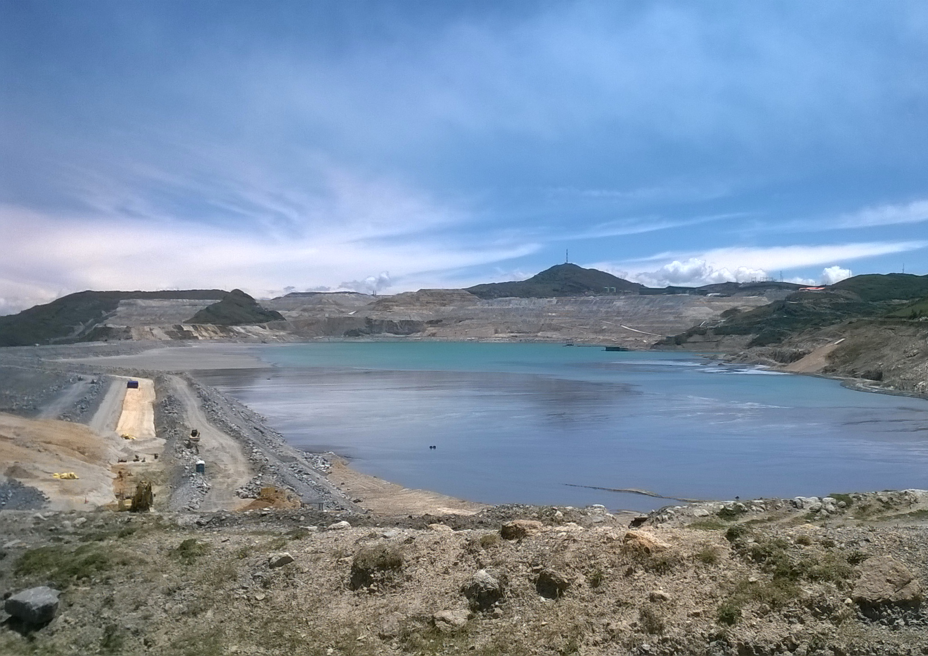
Tailings dams are earth embankments used to store toxic mine waste and effluent.

Slide 3
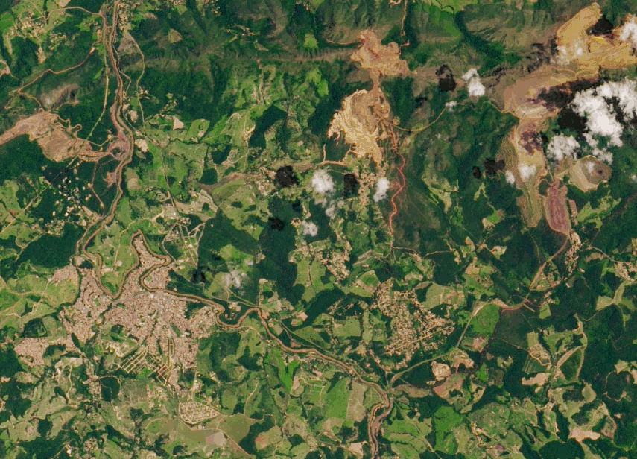
Their failure, as seen for example in January 2019 with the fatal failure of Brumadinho dam in Brazil, can cause:
    loss of life
    irreversible damage to ecosystems
    large economic damages

Slide 4
Tailings dams can fail via various mechanisms:
Tailings dams risk of dangerous occurrences - Lessons learnt from practical experiences, ICOLD Bulletin 121, 2001
See also: A review of the risks posed by the failure of tailings dams, Roca et al. 2019

Slide 5

For the DAMSAT project we designed a multidisciplinary approach to monitoring tailings storage facilities
Site information
This will help users to:
assess the overall status of each site
target their monitoring resources efficiently
contribute to the reduction of environmental and social impacts downstream
Pollution detection
Data integration & assessment
Movement detection
Visualisation
Hydrological forecast
Emergency planning

Slide 6
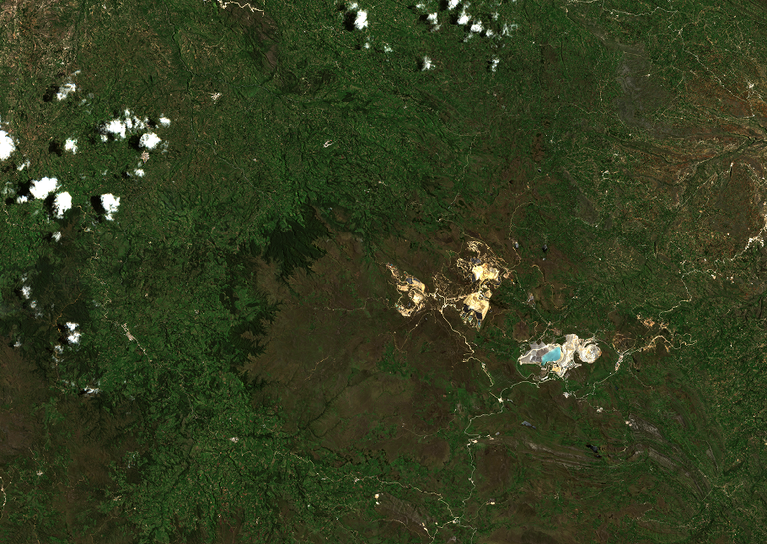
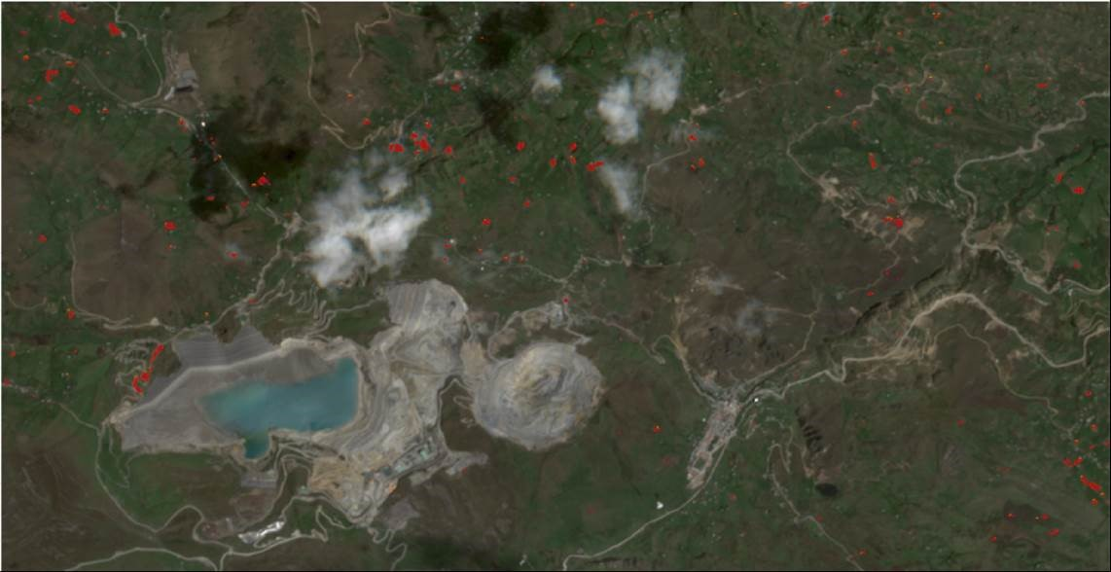
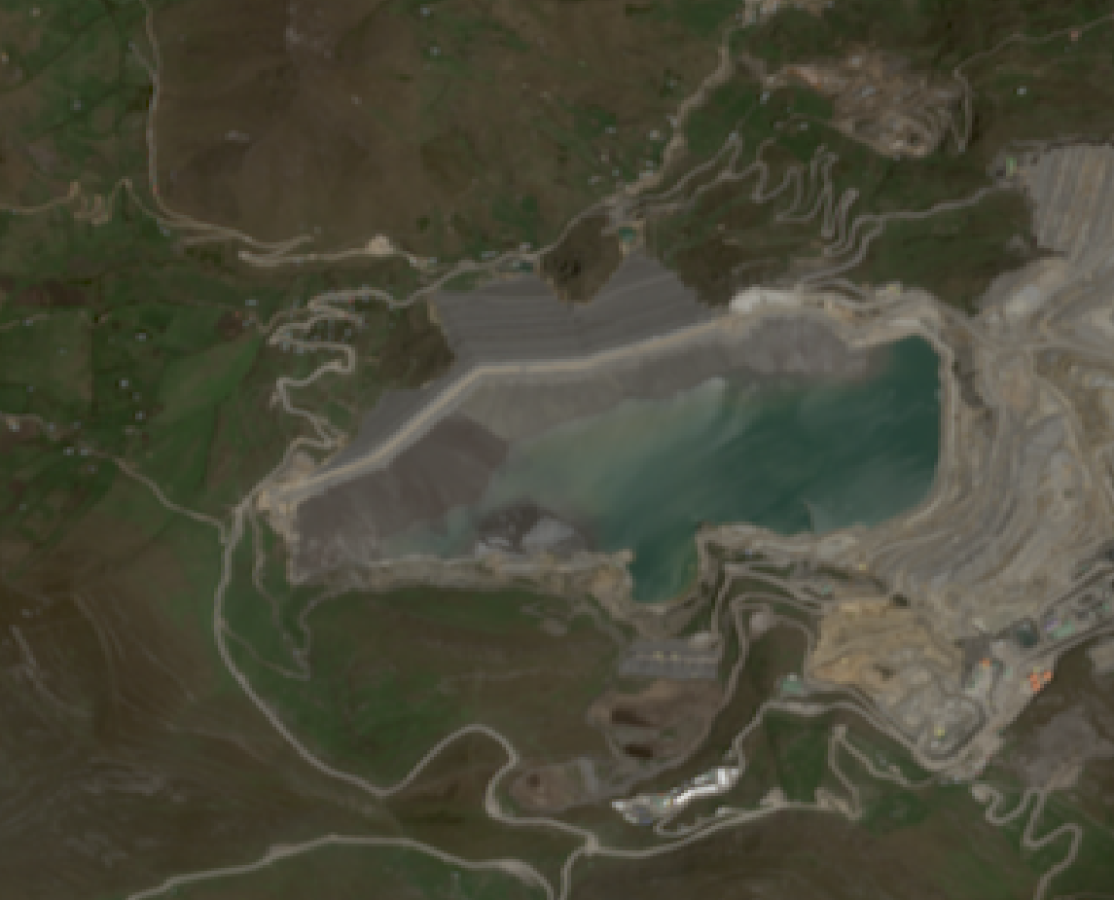
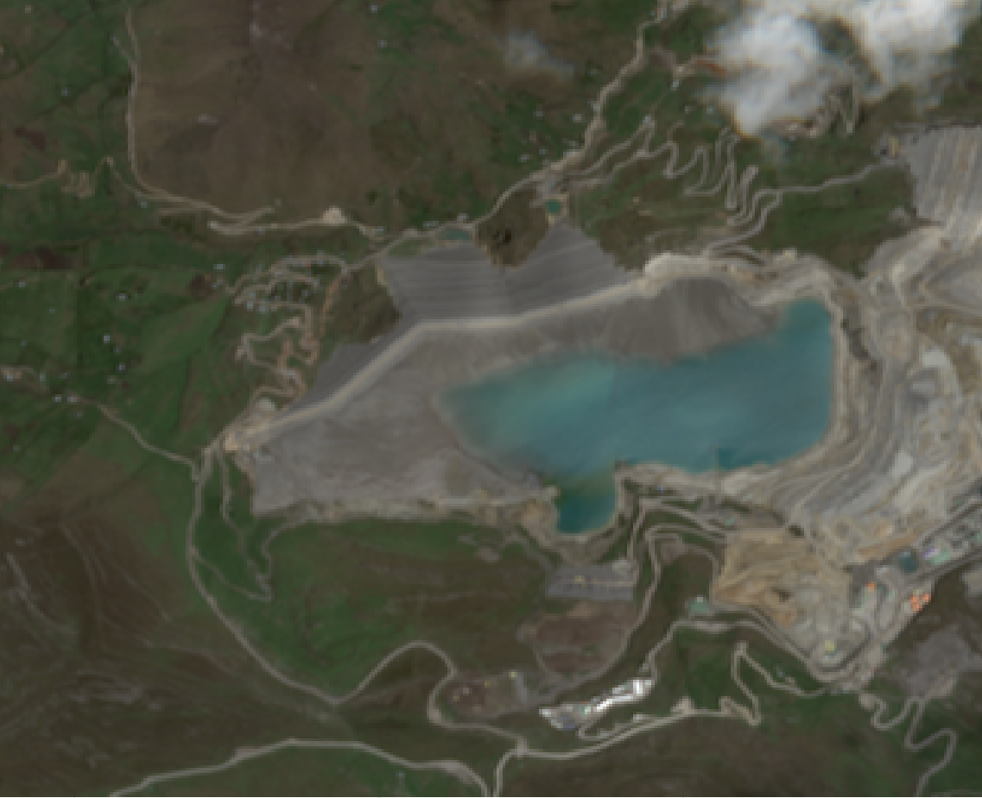
We apply a change detection algorithm based on image differencing of Sentinel-2 MSI satellite images…
…to identify suspected spills and leakage
Because some pollution can’t be detected directly but may effect vegetation health, we also assess changes in NDVI (normalised difference vegetation index)
December 2018
tailings spill
Contains modified Copernicus Sentinel Data 2020

Slide 7
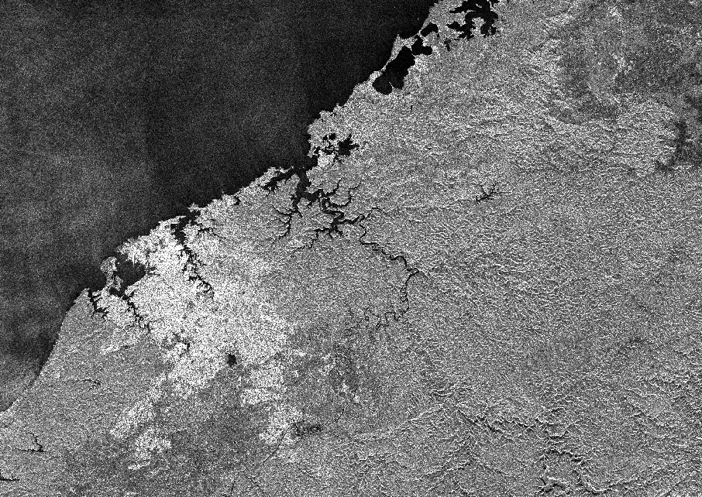
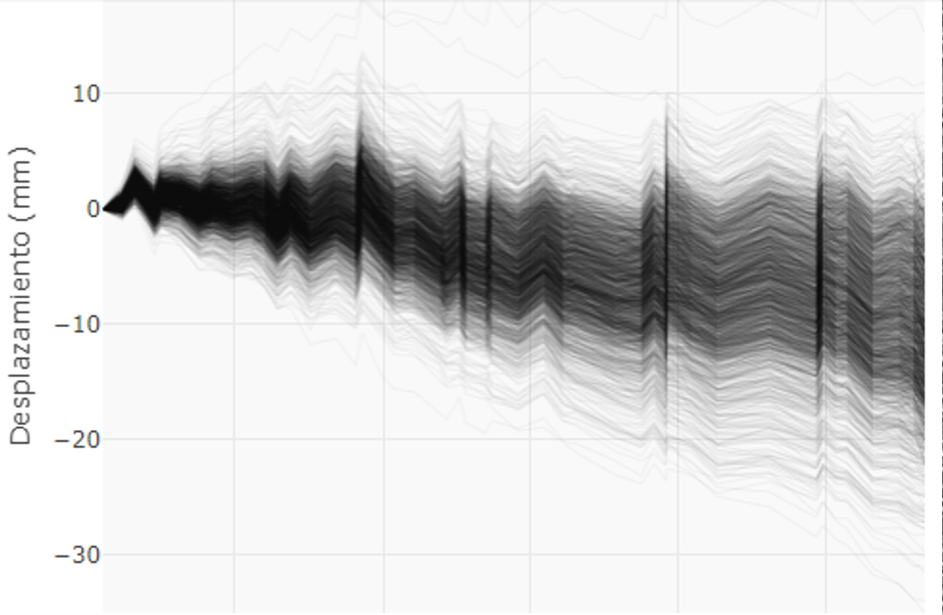
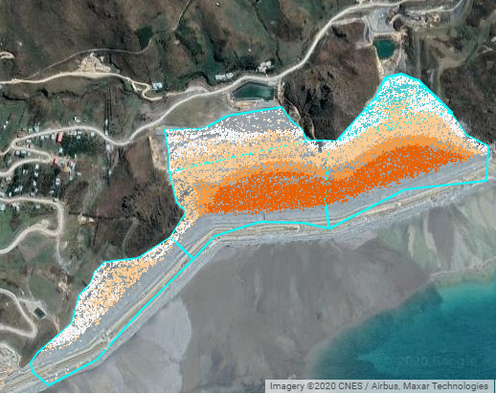
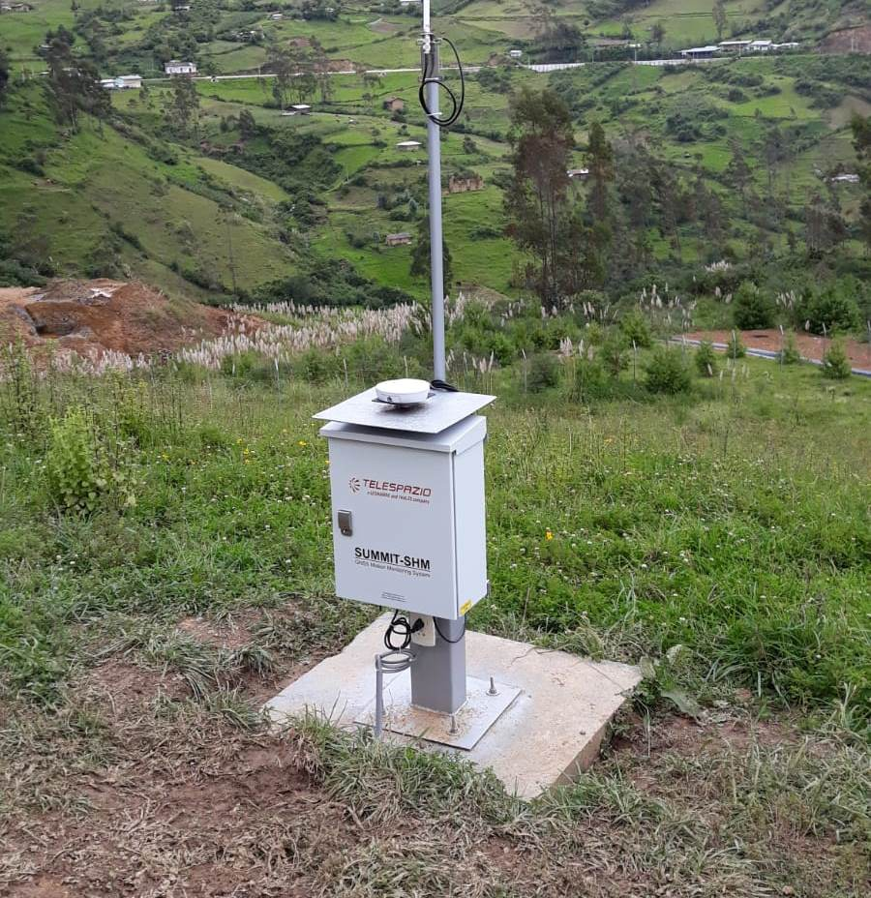
DAMSAT uses time series analysis of satellite InSAR from the Cosmo-SkyMed and Sentinel-1 constellations…
to produce graphs and maps of dam displacement in the line-of-sight direction over recent months
At some sites in-situ GNSS instruments are installed to give higher accuracy and higher temporal resolution measurements
Date
Contains modified Copernicus Sentinel Data 2020

Slide 8
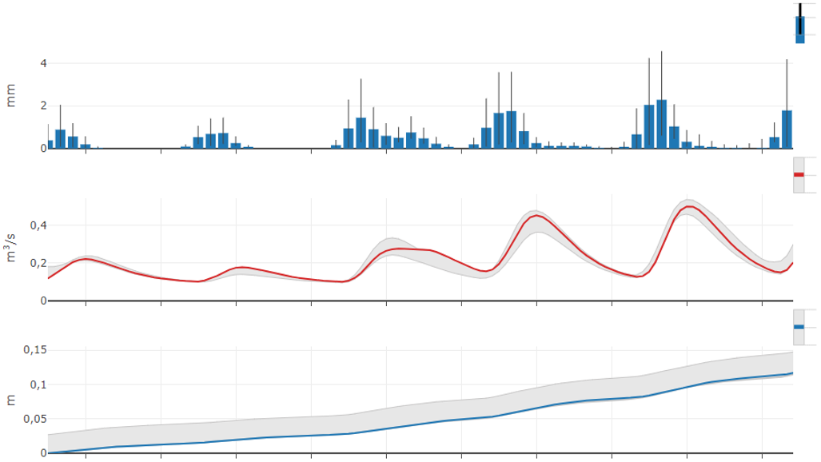
Hydrological forecasting
Rainfall
We use meteorological forecasts and hydrological models…
…to forecast runoff into the tailings pond…
…and the resulting changes in water level
Water discharge
Increase in water level

Slide 9
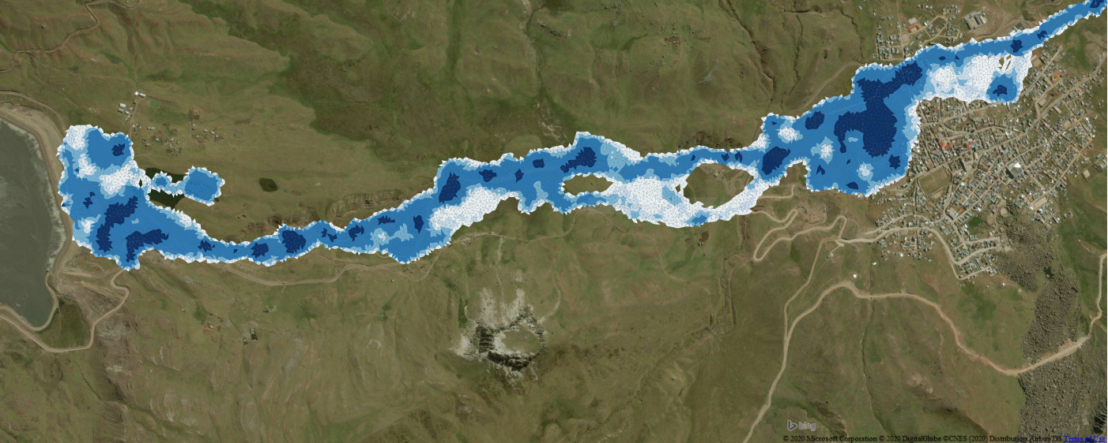
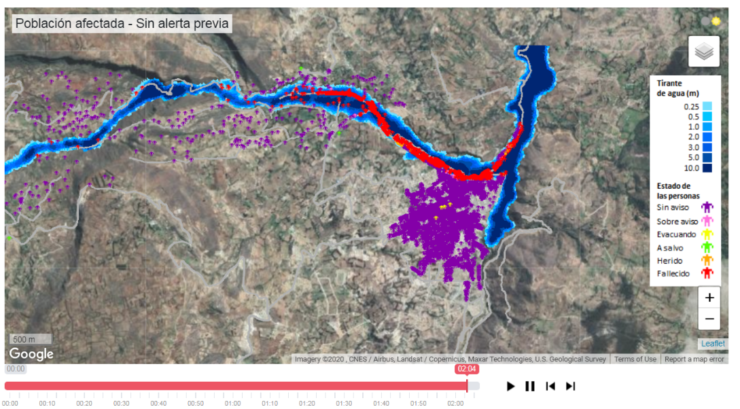
Emergency planning
Alongside the monitoring, we use dam breach, inundation and evacuation models…
…to estimate loss of life and economic damages that could result from failure…
…to assist emergency planning and provide a better understanding of the impacts if a failure occurs
See more in Mark Davison’s presentation, Thursday 7th May 16:15-18:00 in session NH9.6

Slide 10
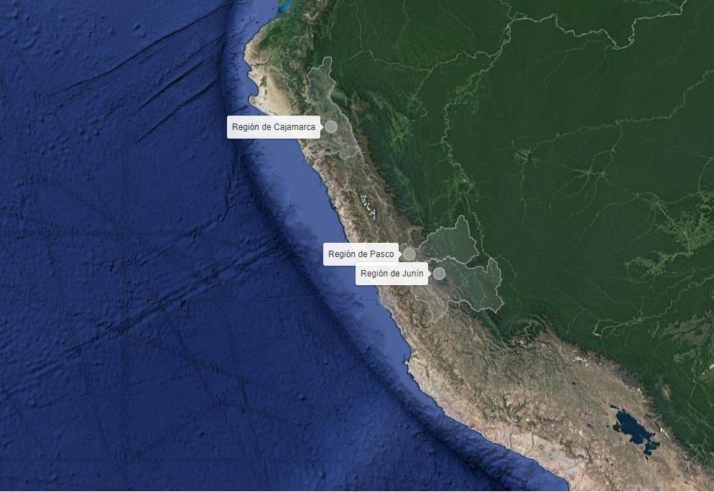
The DAMSAT system is being developed and tested on sites in Peru, focussing on the mining regions of Cajamarca and Cerro de Pasco
Basemap © NASA, TerraMetrics, GoogleEarth

Slide 11


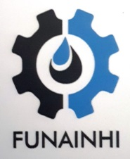








Project team:
Funded by:
more information at www.damsat.org

